Slide 1
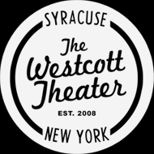
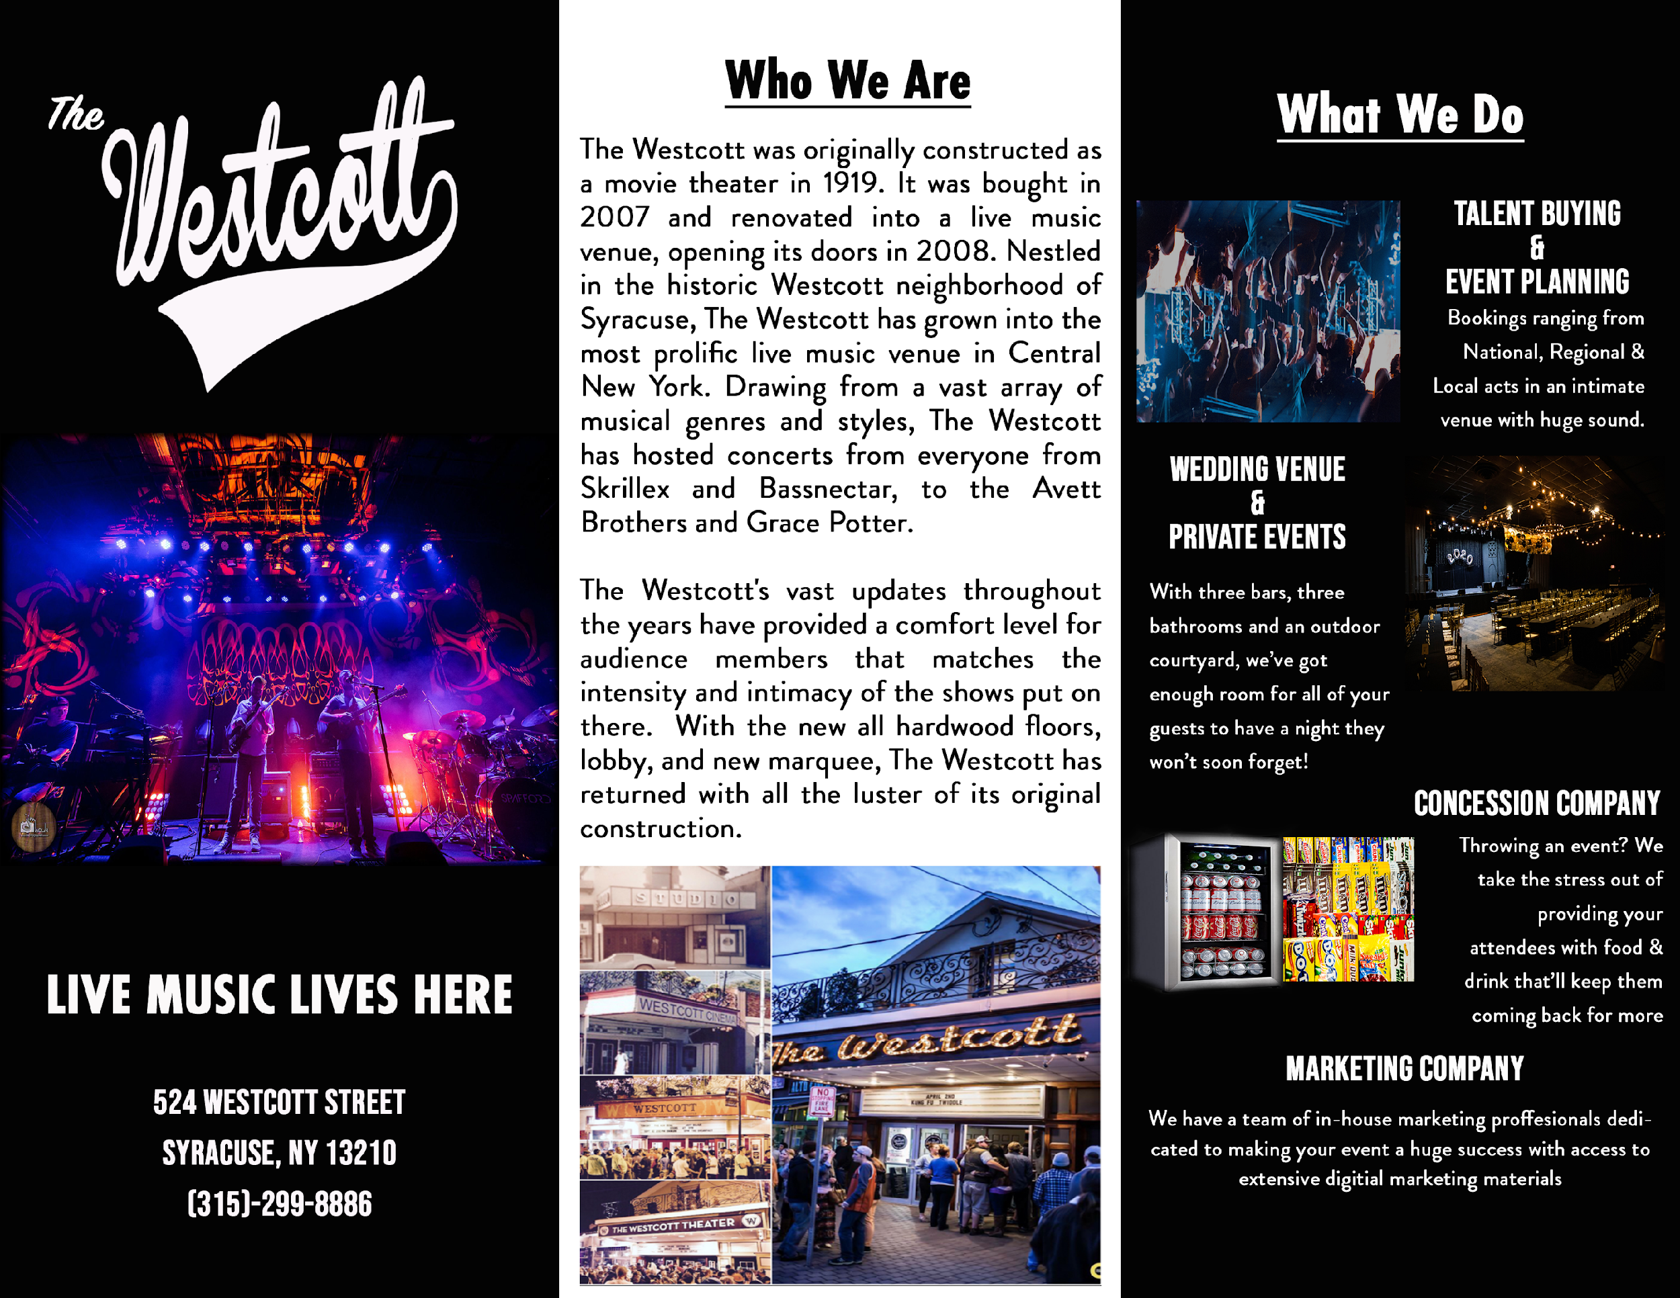
IST625 Enterprise Risk Management Field Project : The Westcott Theater Part 5: Final Presentation
Group 1:
Sophie Teitel, Tanya Shrivastava,
Lalit Mohan, Seongil Kim
Apr 16, 2020
Syracuse University
School of Information Studies
Notes:
We group 1 analyzed the risks of the Westcott Theater, a regional mid-sized live performance theater.

Slide 2
Agenda
Introduction
1. Industry Overview
2. Company Overview
Research
3. Research Methods
4. Interviews and Site Visits
Analysis
5. Swot Analysis
6. Risk Identification & Measurement
7. Risk Heat Map
8. Top 3 Risks
Takeaways
9. Recommendations
10. Lessons Learned
Notes:
We will briefly introduce the method we studied after an overview of the industry and the site itself.
After that, we will go into the full-scale analysis and brief the SWOT analysis results for the business sites.
We will also summarize the risk table and heat map and describe the top 3 risks.
Finally, we will review our recommendations for the venue and the lessons we have learned.

Slide 3
1. Industry Overview
Overview of the Industry (US Live performance theaters)
2019 statistics [7] - Revenue: $9,492M, # of business: 3,377, Employment: 76,145, Avg wage: $34,848
2010: $8,228M (15.4%↑), 3,168 (6.6%↑), 62,191 (22.4%↑), $37,262 (6.5%↓))
US live music ticket sales [8] - 2019: $8,621M, 2023(forecast): $10,095M
2019 world #1 country, Germany (#2): $1,873M
Mature industry, moderate technology change
Low volatility, low concentration
21.2% of the venues are in NY state
Notes:
We chose to cover this industry because it is fast paced and has a lot of interesting risks involved. We can analyze various risks the venue deals with on a day to day basis and understand how to mitigate, transfer, or accept them.
According to US Live performance theaters statistics from IBIS World, revenue in 2019 was $ 9,492 million, up 15.4% over 2010, with 6.6% and 22.4% growth in the number of businesses and employees, respectively. However, the average salary of employees declined 6.5% over the same period, indicating a worsening of earnings compared to quantitative growth.
Meanwhile, according to the International Ticketing yearbook published by IQ magazine, U.S. live music ticket sales for 2019 totaled $ 8,621 million, ranking first among the world's countries. This is overwhelmingly 4.6 times larger than the second-largest Germany. It is also expected to generate sales of $ 10,095 million in 2023, with 17.1% growth over four years.

Slide 4
1. Industry Overview (continued)
Traditional risks [12]
Business: Acquiring & managing musicians, economic crisis, natural disasters (infectious diseases, poor weather), personal injuries & lawsuits, flooding, damage to property
Financial: Insufficient financial performance for a specific period
Operational: ticketing system (system/scanner malfunction, data loss), building safety
Security: Mass shootings, theft
Safety: Fire and smoke, heat exhaustion and dehydration, intoxication
Notes:
There are various risks to running live performance theaters. According to the SEC filing of Live Nation Entertainment a major performance promotion agency, and so on, there are various risks in the live performance industry. Managing musicians to perform, physical safety issues for audiences and musicians. In addition, security and maintenance of performance hall buildings and preparation for various natural disasters are needed. Financial risk management should also be undertaken to ensure that the firm does not go bankrupt or suffer financial difficulties. If the operation of the ticketing system is not thorough, it may damage the reputation of the workplace and reduce the number of customers.

Slide 5
2. Company Overview
700-person multi-purpose, cinema-style concert venue [1]
Formerly known as the Westcott Cinema, re-purposed in Oct. 18, 2007 as concert venue [1]
Two full bars which serves a few food options
Offers all age events and 18+ events
Believed to be the most consistent midsize venue in Syracuse with about 120 shows annually [1]
Hosts entertainment of all genres
From Skrillex to Grace Potter, local talent, cover bands, magic shows, burlesque shows, and comedians
Notes:
History : The building that is now known as the Westcott Theater was first constructed in 1919. Formerly called the Harvard Theater and then the Studio, the theater originally acted as a cinema hosting a variety of films ranging from vaudeville films to more risqué adult films.

Slide 6
3. Research Methods
Interviews
Wes Johnson- Manager of the theater (audio recorded in person)
Sophie Teitel - an employee of the theater (audio recorded virtually)
Colin Hozza - a local artist for the theater (virtual not recorded)
Site Visits
One visit during closed hours to inspect while theater is empty
Second visit while the theater is full during an event
Articles
Go Westcott, Young Men: Syracuse New Times (2008)
Battling the odds, Westcott Theater celebrates 10 years as a music venue: Syracuse New Times (2018) etc.
Notes:
We went through many articles and journals to gather information about the theater, having a teammate working at the theater did help a lot in gathering information and scheduling the interviews.
The interviews were in person as well as virtual interviews on zoom.

Slide 7
4. Interviews and Site Visits
Site visit at Westcott Theater
March 11, 2020 - Observation of theater, staff, and attendees during live event (3 hours - Sophie)
March 12, 2020 - Observation/ inspection of apparent risk of theater (30 minutes - Sophie, Tanya, Lalit, Seongil)
Interview
March 12, 2020 - Wes Johnson (manager) at Westcott Theater (30 minutes - Sophie, Tanya, Lalit, Seongil)
March 30, 2020 - Sophie Teitel (employee) via Zoom (30 minutes - Tanya, Lalit, Seongil)
March 31, 2020 - Colin Hozza (local artist for theater) via Zoom (30 minutes - Sophie)
Notes:
One of our teammates, Sophie, was able to see the risk factors during the live event since she works at the venue.
We all visited the theater during times when performances were not held, looked at the state of building and stage equipment, and checked the safety of stairs and an emergency door.
The interview took place three times. First, we interviewed the manager in charge of theater operations and heard the overall situation, history, and how he is managing risks. Second, we interviewed the employee here, Sophie, to grasp the worker's viewpoint, and third, we understood the current status of the place's risk from a customer's perspective by interviewing an artist performing at this venue.

Slide 8
5. SWOT Analysis
STRENGTH
WEAKNESS
Most consistent mid-size venue
Performs various genres
Good relationships with other venues
Loyal customer base
Safer than other venues
Staff not aware of safety procedures
Very old building, one emergency exit
Lack of preparedness for recession
Artists have to walk through crowd
No contingency plan
OPPORTUNITY
THREAT
City population growth (due to a new Amazon center)
Multiple nearby colleges
Big wave of people after pandemic
Corona pandemic
Natural disaster, fire
Injuries
Faulty equipment
Lawsuits
Notes:
We conducted SWOT analysis based on the visits to the venue, interviews, and collected data.
Through this analysis, we have summarized our findings so far, and have screened risks through weaknesses and threats.

Slide 9
6. Risk Identification & Measurement
Risk | Measurement & Metrics Used | Management Strategy Applied
Fire: damage to property and/or people | number of sprinklers and fire extinguisher; frequency of fire drills | Transference: insurance, Mitigation: regular inspection and fire drill
Drinking: underage drinkers / intoxication | age of attendee; frequency of incidents | Mitigation: right to refuse drink, removal of intoxicated people, wristbands for under 21
Artist cancelation or no show | frequency of cancellation; notice before cancellation | Mitigation: refunds or rescheduling
Structural faults: sloped floor, narrow stairway, one emergency exit | structural integrity ratings; regulatory standards | Transference: insurance (in case of an accident)
Notes:
These are the risks of the venue.
The fire has not happened recently.
Accidents due to underage drinking attempts or excessive drinking are prevented by continuously monitoring the audience during the performance.
Artists’ unexpected cancellation of a performance often happens.
The risk of safety accidents exists because the building is old. It is transferring risk by subscribing multiple insurance policies.
In October 2012, there was an accident where a part of the ceiling fell down. The accident occurred during the performance and a small number of audiences were injured. The venue was reopened a few days after the repair. [5]

Slide 10
6. Risk Identification & Measurement (continued)
Risk | Measurement & Metrics Used | Management Strategy Applied
Equipment problem: speakers blowing, cables missing, CDJs not reading flash drives | frequency of malfunction; duration of equipment offline; time required to fix issue | Mitigation: employee on sight, replacements for inexpensive equipment
Theft | frequency of incident; value of stolen items | Mitigation: cameras inside & outside theater
Injury: patrons, artists, employees | frequency of incident; extent of injury | Transference: insurance
Notes:
Risks of the venue continued.

Slide 11
7. Risk Heat Map
Catastrophic | Pandemic, Natural Disaster, Active Shooter |  |  | Employees unaware of protocol in emergency
Significant |  |  | Fire | Injuries of artists, patrons and employees
Moderate |  |  | Equipment problems | Structural faults
Minor | Theft of equipment |  | Artist cancelation or no show | Underage drinkers / Intoxication
Insignificant
 | Rare | Unlikely | Possible | Likely | Almost Certain
Priority
Very High
High
Impact
Mode-rate
Low
Very
Low
Likelihood
Notes:
We classified the likelihood and impact of risks on five scales each.
Likelihood (chance of annual occurrence): Rare (less than 5%), Unlikely (5-15%), Possible (15-40%), Likely (40-80%), Almost Certain (80% or more)
Impact (ratio of lost amount to annual income and/or life-safety threat): Insignificant (less than 1% and/or very low life threat), Minor (1-10% and/or low life threat), Moderate (10-25% and/or moderate life threat), Significant (25-40% and/or serious life threat), Catastrophic (40% or more and/or significant life threat)

Slide 12
7. Risk Heat Map (continued)
Employees unaware of emergency protocol
Impact is catastrophic as employees cannot take any steps to reduce it
Fire
Impact reduces (catastrophic→significant) due to risk transference through insurance
Likelihood decreases (likely→possible) due to mitigation like inspection fire drills
Structural faults
Impact is reduced (significant→moderate) by transferring through insurance
Injury of patrons, artists and employees
Impact is significant since the reputation is also at stake & higher insurance premium due to the previous incident
Underage drinkers/ intoxicated attendees
Likelihood goes down (almost certain→likely) due to ID checks and 21+ wristbands
Notes:
This slide describes the impact and probability of each risk.
It also explains how each risk is currently managed by the Westcott Theater.

Slide 13
7. Risk Heat Map (continued)
Global Pandemic/Natural disaster/Active Shooter
Catastrophic impact but rare likelihood
No mitigation or transference strategies
Equipment problems
Likelihood is possible since an employee monitors during the show
Impact is moderate as inexpensive ones have replacements on sight
Artist Cancelation or no show
Impact reduced (moderate→minor) due to mitigation such as rescheduling and refunding
Theft of equipment
Likelihood reduces (possible→rare) due to mitigation through security cameras
Impact also reduces (moderate→minor) due to risk transfer through insurance
Notes:
Description of the impact and probability of each risk continues.

Slide 14
8. Top 3 Risks
SAFETY TRAINING LACKING
Staff members and regular performers do not know basic safety protocol in case of fire or other emergency
INJURY RISKS TO PATRONS or ARTISTS
Risks from fights, crowd surfing, people on shoulders, slipping/ falling, fans getting too close to artists, steep & narrow stairs.
STRUCTURAL FAULTS
Ceiling problems, front rail moving, flooring issues, broken doors, emergency exit functionality.
Notes:
After analyzing risks of the venue, we came up with the top 3 risks which the manager and employees should keep eyes on.

Slide 15
9. Recommendations
To avoid/mitigate safety risks:
Remodel the floor so there isn't a slant & rewire stage area
Have training for all staff members on safety protocol
Place emergency instructions for the artists and the audience in sight
To mitigate/transfer business risks:
Keep alternate equipment and insure expensive ones
Consider starting “Westcott Virtual Live” [3][9]
To transfer financial risks:
Consider insuring for a long recession
Make contingency plans for risks
Notes:
After engaging in several interviews and conducting our own research these are the recommendations our team has come up with for The Westcott Theater.
One way to mitigate business risk is to provide online streaming performance to customers. In fact, due to the Corona19 crisis, the art world is paying attention to online performances. Ithaca's Cinepolis Theater has been serving their virtual cinema since April 10th. [3] They get $ 12 for one movie. As another example, playwright Danielle Mohlman will run her play Nexus on Zoom from April 17 to May 2. [9]

Slide 16
10. Lessons Learned
ERM perspectives
Ensure business insurance covers specific risks
Self insure for residual risk
Have backup dates for shows
Have alternate methods for critical operations
Employees should be trained for emergencies
Lessons during the research
Risk management strategies can be long/ short term
People have different perspectives on risk management
Interviewer should uncover explicit and implicit risks
Notes:
To finish out our presentation we have a few main takeaways from all of our research over the past few weeks.

Slide 17
References
About the Westcott Theater. (n.d). Retrieved from https://thewestcotttheater.com/affiliates.cfm?searchurl=about
Avery, B. (2012). Event risk management - events and attractions safety services. Retrieved from http://eventsafetyservices.com/event-risk-management-for-meeting-planners-and-venue-operators-forward-thinking/
Cinemapolis. (2020). Virtual cinema. Retrieved from https://cinemapolis.org/virtual-cinema/
Corporate. (2019). Concert risk management: establishing crowd control. Retrieved from https://www.usrisk.com/2019/02/concert-risk-management-establishing-crowd-control/
Duroe, L. (2019). Health and safety in the music events industry. Retrieved from https://www.airsweb.com/blog/health-and-safety-in-the-music-events-industry-2
Herbert, G. (2012). Part of ceiling falls at Westcott Theater during Dada Life show; injuries reported. Retrieved from https://www.syracuse.com/entertainment/2012/10/ceiling_falls_westcott_theater_dada_life_syracuse.html
IBISWorld. (2020). Live performance theaters in the US market size and so on. Retrieved from https://my-ibisworld-com.libezproxy2.syr.edu/us/en/industry-specialized/od5359/about
Notes:
References for the articles and journals which we went through to gather information about this project.

Slide 18
References (continued)
International ticketing yearbook 2019. (2019). Retrieved from https://www.iq-mag.net/publications/the-international-ticketing-yearbook
Marks, P. (2020). In the midst of the virus, theater migrates to the web. The results are spotty. Retrieved from https://www.washingtonpost.com/coronavirus/in-the-midst-of-the-virus-theater-migrates-to-the-web-the-results-are-spotty/2020/04/09/fdf81004-78d1-11ea-a130-df573469f094_story.html
McDonald, C., & Jon, D. (2017). Large venues reviewing security. Retrieved from https://www.riskmanagementmonitor.com/large-venues-reviewing-security-m
Reilley, D. (2020). How coronavirus is affecting the global concert industry, including SXSW and Coachella. Retrieved from https://fortune.com/2020/03/09/coronavirus-impact-music-concert-tickets-industry-cancellations-sxsw-coachella/
SEC filing annual report form 10-K. (2020). Retrieved from https://www.sec.gov/ix?doc=/Archives/edgar/data/1335258/000133525820000028/lyv-20191231.htm
Young, C. (2020). Concert industry continues growth in 2020. Retrieved from https://www.prosoundnetwork.com/live/concert-industry-continues-growth-in-2020
Notes:
References continued.

